Slide 1
Media-Online Management (MOM)
SW701
Jens Mikkel Lauridsen, Johan Sørensen, Tommy Knudsen, Lisbeth Nielsen, Jakob Jørgensen and Lars Chr. Pedersen

Slide 2
Too much media
Danish Health Department
2,47
1,57

Slide 3
It can lead to
Sleep deprivation
Lack of physical exercise
Type 2 diabetes
Concentration issues

Slide 4
Problem Statment
Parents are not able to help their children administer their IT/TV consumption. This results in their children getting a lessened learning ability, a bad sleeping pattern and a higher risk of type 2 diabetes. How can hardware identification and webservices give parents the tools to help their children manage their media consumption?
To address this problem, we face the following technical challenges:
How do we identify unique users in a subtle and child friendly way.
How do we enforce restrictions on media devices.
How do we facilitate concepts as rules, permissions and chores without parents interaction.

Slide 5
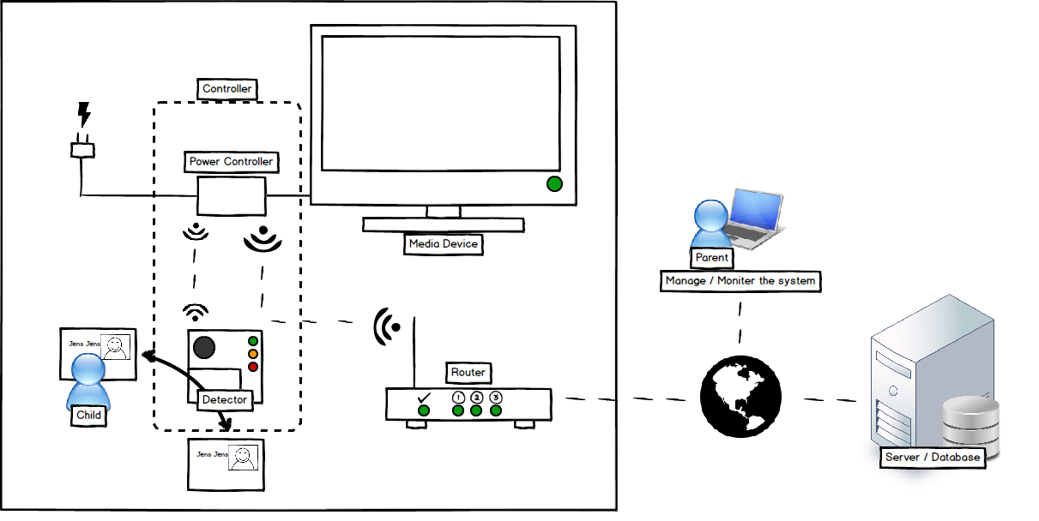
MOM an Overview

Slide 6
Rules in The System
The rule concept
Real life rules
A child is grounded
A child are only allowed to watch TV from 16:00-19:00
A child get an allowance (in points) in the beginning of each month or week.
Parents must have access to any media, any time

Slide 7
Current Construction of a Rule
<Rule>:= <name>(
(<ActionsetSet1><ConditionSet1>)*
…
| (<ActionsetSet5><ConditionSet5>)*)
<ActionsetSet5> := ("Access controller" | "Cannot access controller") <Controller>
<ConditionSet5> := <ConditionTimeperiod>
|<ConditionTrue> | <ConditionElse>
<ConditionElse>:= ("Device on" | "Device off") <Controller>

Slide 8
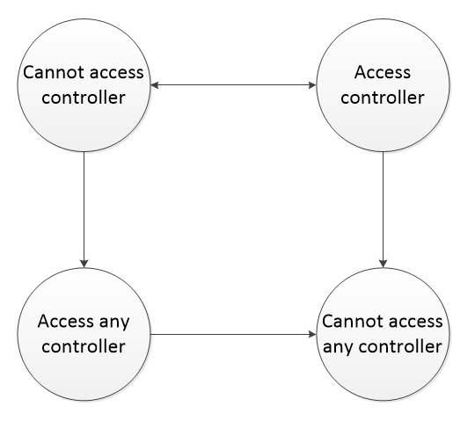
Rules can conflict - precedence
Precedence over Cannot access controller and Access controller depends on the Condition
Notes:
Timeperiod over true
Timeperiod non-repeat over repeatable
If both the same then access controller

Slide 9
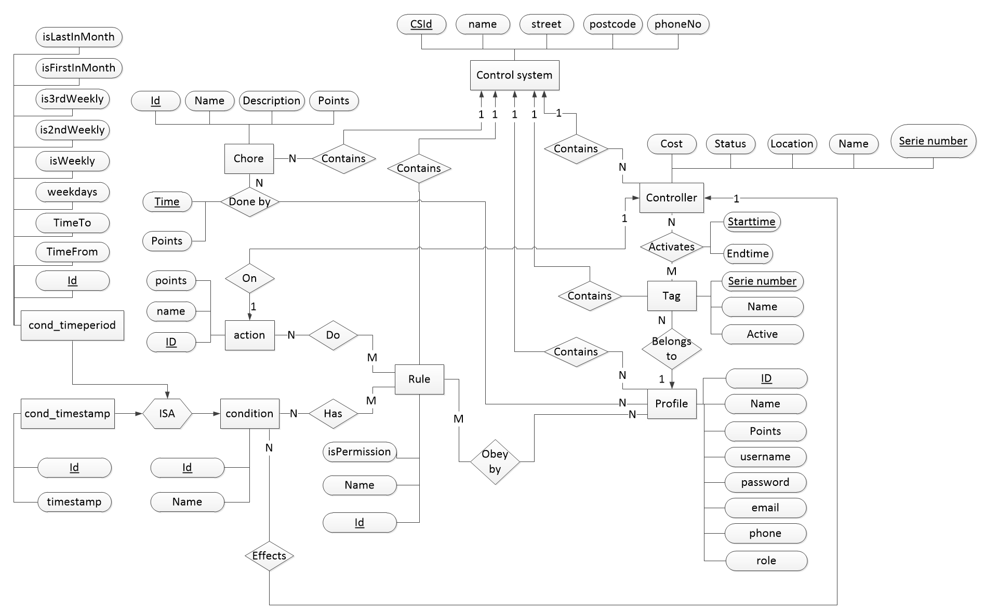
Rules in the Database

Slide 10
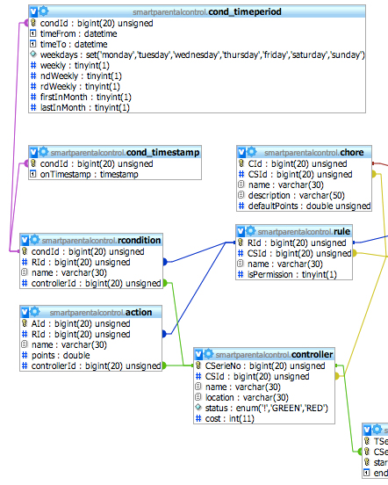
Rules in the Database
Mapping rules using partitioning
Notes:
Using main classes (repeat attributes)
Using partitioning, (the one used)
Using partitioning, (like 1. but all tubles is in cond -reduncancy attributes in the tables)
Using single relation, all attributes in one relation – alot of null values

Slide 11
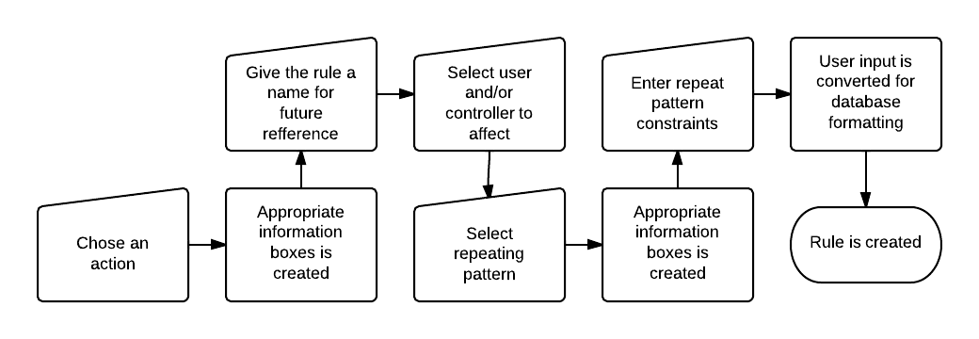
Rule in the WEB Interface

Slide 12
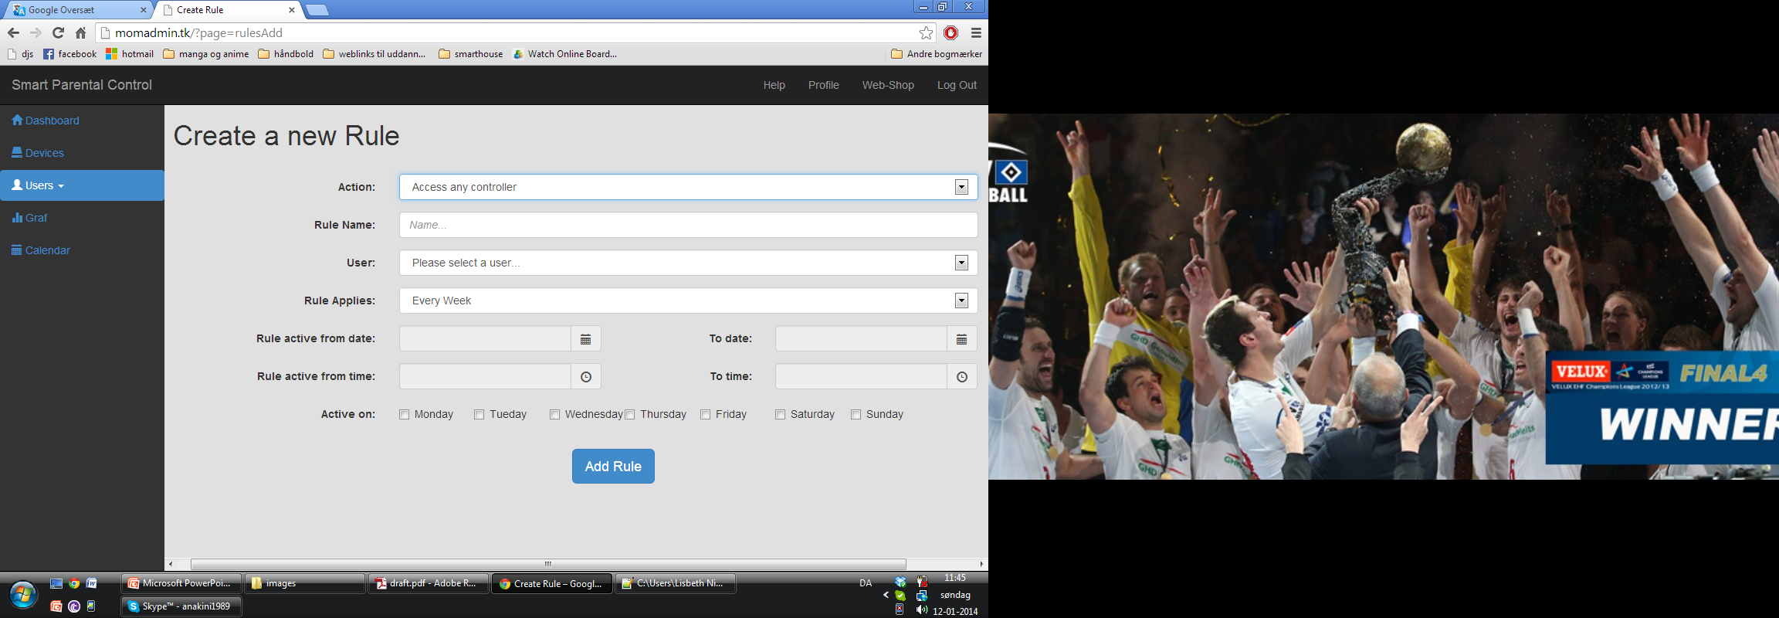
Rule in the WEB Interface

Slide 13
Rule design in the future
Rule design to the drawing board again
All rules should have at least a start date
Consider further whether multiple conditions and actions should be allowed or not
Rule overlapping
Should it still be allowed to make several overlapping rules?
Make the user aware when he makes an overlapping rule

Slide 14
Controller

Slide 15
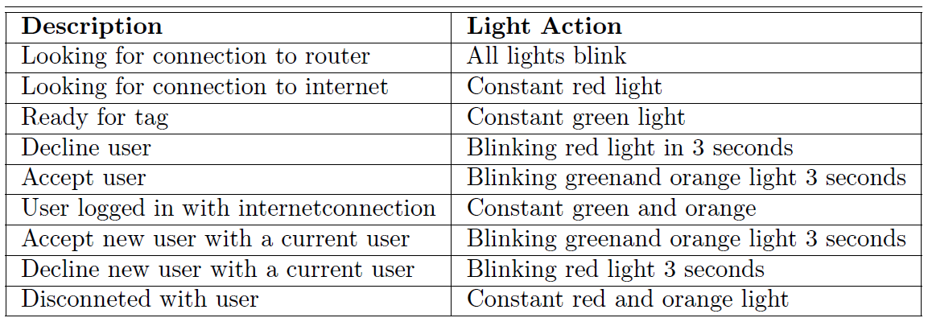
Controller
The System is developed with focus on functionalities
Prototype for best use of resources
User cases
Exception handling.

Slide 16
Controller
Further work/testing

Slide 17
The Daemon - Design
A Background Service that runs without User input
That activates rules that need to be set off at a certain point in time, once or repeated
Implemented with Python as it has this functionality
Currently only functions to add points
Could be expanded to handle ”Activate Tag” and ”Block Tag”

Slide 18
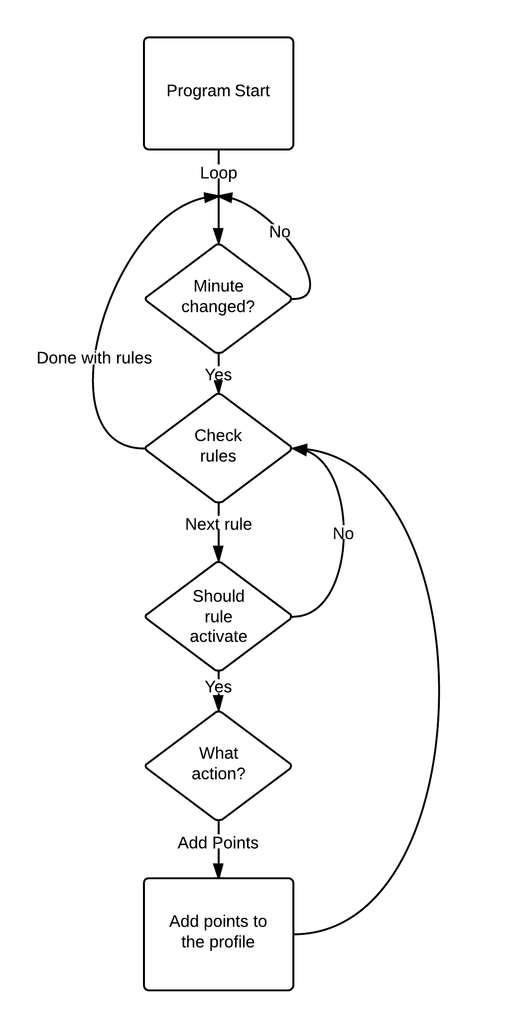
The Daemon
Example of functionality:
Communicates directly with the Database
Checks the rules with:
Actions
Conditions
Profiles
Checks every minute
The checks are based on from/to time and options to repeat
Weekday: Checks with time from/to time on weekdays without repeatability
Weekly: Activates based on the difference between the date it starts and the date it checks
Last/First of: Activates if the current day is the first or last of a given weekday of the month

Slide 19
The API – Design
A middleman between the Database and controller
Is made to be simple with 3 commands
Get Status: Allows for the controller to check how much time is left or if it needs to turn off
TurnOn: Asks permission to turn on. Checks permissions and time remaining
TurnOff: Tells the database that the user wants to turn off. Checks if its the user that logged in first

Slide 20
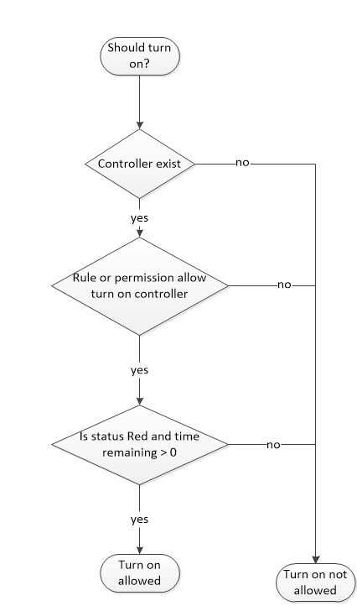
The API – Implementation
TurnOn - Call by:
http://example.com/api/api.php/turnOn/cID/tID
Returns:
{”status”:”OK”, ”timeRemaining”:”value”}
or
{”status”:”ERROR”,”error”:”Error Message”}

Slide 21
Conclusion
The project has delivered a prototype ready to be tested after a few updates and fixes
We can Identify unique users with Tags
We can facilitate chores, rules and permission without constant parental interaction using the website, controller and daemon
We can enforce the restrictions with an Arduino based Controller

Slide 22
Future Work pt.1
Bug Reports
Improve on current features:
Rules and Database re-design
Fully Implement Calendar
Improve how chores are finished
Error Handling on lost connection
Have the Daemon detect connection drops

Slide 23
Future Work Pt.2
Adding new Features:
Learning User Habits
User Friendly Setup of the controller
Accompanying Mobile Application

Slide 24
Demonstration

